Slide 1
Big Data Analytics:
Project
STA-CN-17031
A presentation by Lanre Uzamere

Slide 2

Abstract
In this presentation, we will be using big data technologies and tools to handle the UNSW-NB15 dataset created by the IXIA PerfectStorm tool in the Cyber Range Lab of the Australian Centre for Cyber Security (ACCS)

Slide 3


Introduction
The aim of the project is to understand the UNSW-NB15 dataset and apply big data technologies including Apache Hive and PySpark to analyze and interpret big data. This will help us have a clue of the network intrusion events in other to design and build classifiers.

Slide 4
Brief Background
Many challenges for cyber security research have arisen because of the massive growth in computer networks and applications. Network Intrusions or attacks is a cyber security challenge which is a series of events that have the potential to jeopardize computer system principles such as availability, authority, confidentiality, and integrity (Heady et al., 1990). Firewall systems are incapable of detecting modern attack environments or performing in-depth network packet analysis (Aydın et al., 2009).

Slide 5
Brief Background
In response to this challenge, there was an effort to develop a UNSW-NB15 dataset for evaluating Network Intrusion Detection Systems (NIDSs) that monitors network traffic flow to detect attacks. The IXIA PerfectStorm tool is used in the ACCS Cyber Range Lab to generate a hybrid of modern normal and abnormal network traffic. The abnormal traffic generated by the IXIA tool simulates the nine attack families including Normal, Fuzzers, Analysis, Backdoors, DoS, Exploits, Generic, Reconnaissance, Shellcode and Worms. The IXIA tool contains all information about recent attacks that are constantly updated from a CVE website. This website is a lexicon of publicly available information security vulnerabilities and exposures (Moustafa & Slay, 2015).

Slide 6
The UNSW-NB15 Dataset
The UNSW-NB15 dataset contains about 2,540,044 realistic modern normal and abnormal (attack) network activities.
THAT’S MORE THAN A RDBMS CAN HANDLE WITHOUT BREAKING DOWN OR RIDICULOUSLY SLOW.
Hence, the need to apply big data technologies and tools like Apache Hive and PySpark to analyze and interpret big data.

Slide 7

Big Data Query & Analysis by Apache Hive
Apache Hive was used to convert big raw data (UNSW-NB15 dataset) into useful information to buttress our understanding of the dataset by uploading the dataset in Hive on Cloudera Quickstart VM, making some Hive queries and applying visualization tools including Pie charts and Bar charts to present the results numerically and graphically. Then interpreted the results. Some of the Hive queries, results and visualizations are demonstrated below.
What is Hive?
“Hive is an open source data warehouse software, similar to SQL, for reading, writing and managing large data sets that are stored in Apache Hadoop files”
(IBM, 2020).

Slide 8
Hive Queries
The dataset was queried to SELECT the SRCIP column (unswnb15.srcip) and COUNT the LABEL(unswnb15.label) per source IP connection (for each count represents a single connection), named the result columns (AS) SourceIP and Numberofconnections respectively, FROM the UNSWNB15 dataset. I then grouped the result by (GROUP BY) the SRCIP (unswnb15.srcip) and sorted it using (ORDER BY)the Numberofconnections in descending order (DESC).
The query returned 43 records with the Source IP and counted the number of labels (0 and 1) for each source IP as Numberofconnections in descending order. The number of labels (0 and 1) per source IP here is used to determine the number of times the source IP (SRCIP) is connected to the network by counting the number of labels for each source IP. Screenshots of the hive query and the output are shown below.
Hive Query 1
SELECT unswnb15.srcip AS SourceIP, COUNT(unswnb15.label)AS Numberofconnections
FROM UNSWNB15
GROUP BY unswnb15.srcip ORDER BY Numberofconnections DESC;

Slide 9
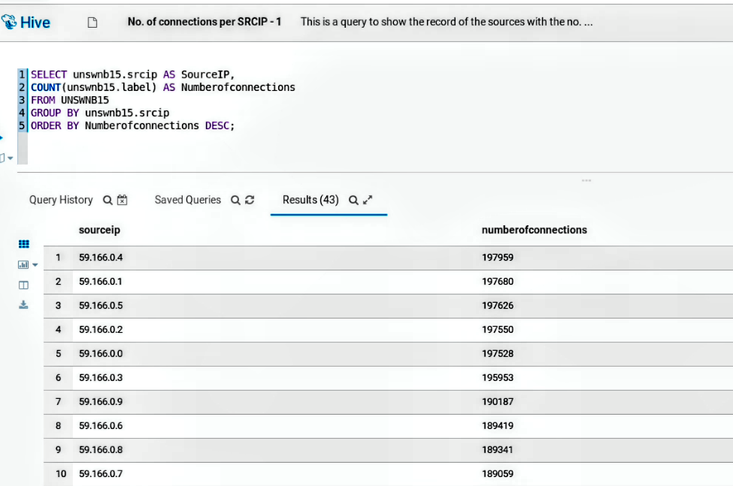
Hive Queries
Hive Query 1: Result

Slide 10
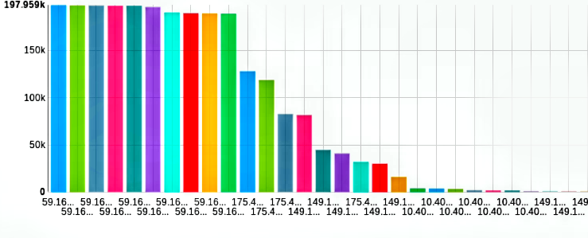
Hive Queries
Hive Query 1: Visualization

Slide 11
Hive Queries
The dataset was again queried to SELECT the Source IP (unswnb15.srcip), SUM the Duration of each source IP connection (unswnb15.dur), SUM the number of Source bytes transmitted by each source IP (unswnb15.sbytes), SUM the number of Destination bytes transmitted by each source IP (unswnb15.dbytes), then COUNT the number of connection by each IP through a service (unswnb15.service), output the columns AS SOURCEIP, TOTALDURATION, SOURCEBYTES, DESTINATIONBYTES and NUMBEROFHTTPCONNECTION respectively, FROM the UNSWNB15 dataset WHERE the service type is HTTP AND Protocol type is TCP. I then grouped the result by (GROUP BY) the SRCIP (unswnb15.srcip) and sorted it using (ORDER BY)the NUMBEROFHTTPCONNECTION in descending order (DESC).
The query returned 17 records with the Source IP as sourceip, the sum of Source bytes as sourcebytes, the sum of Destination bytes as destinationbytes, and counted the number of HTTP connections for each source IP connected to the network through HTTP service and TCP protocol as numberofhttpconnections. A screenshot of the hive query and the result are shown below.
Hive Query 2
SELECT unswnb15.srcip AS SOURCEIP,
SUM(unswnb15.dur) AS TOTALDURATION,
SUM(unswnb15.sbytes) AS SOURCEBYTES,
SUM(unswnb15.dbytes) AS DESTINATIONBYTES,
COUNT(unswnb15.service) AS NUMBEROFHTTPCONNECTION
FROM UNSWNB15
WHERE unswnb15.service = 'http' AND unswnb15.proto = 'tcp'
GROUP BY unswnb15.srcip
ORDER BY NUMBEROFHTTPCONNECTION DESC;

Slide 12
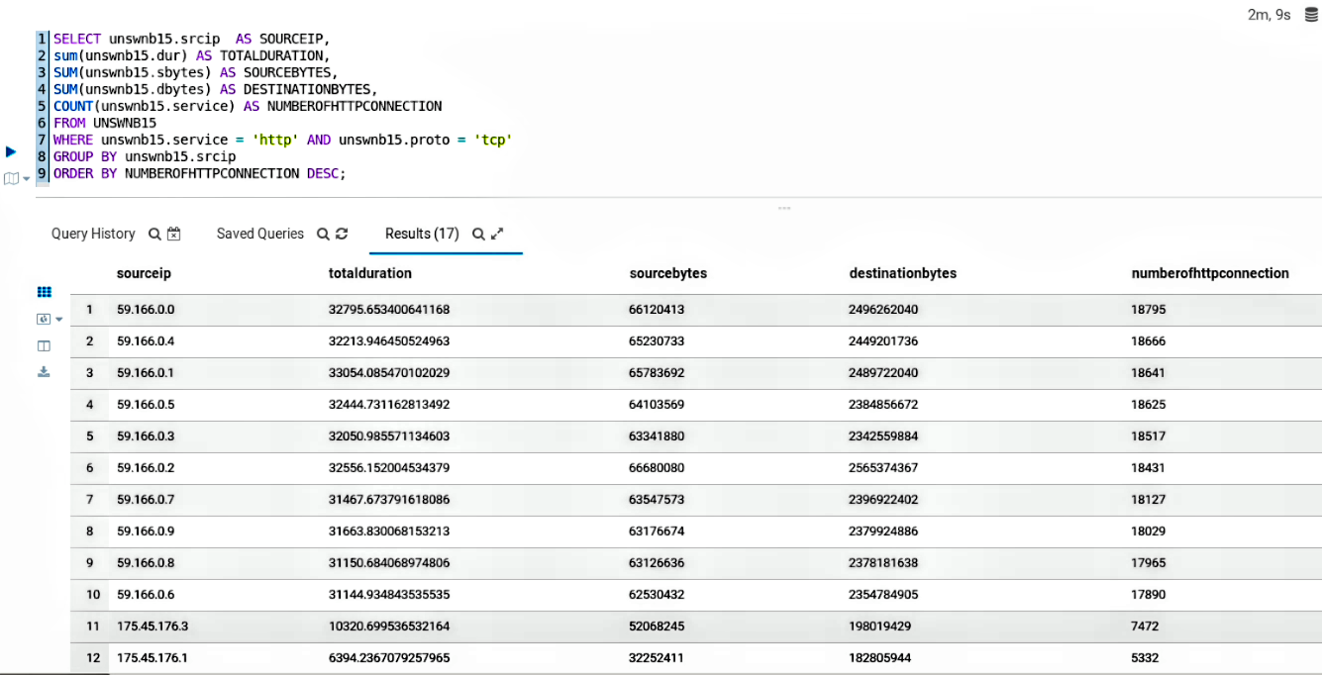
Hive Queries
Hive Query 2: Result

Slide 13
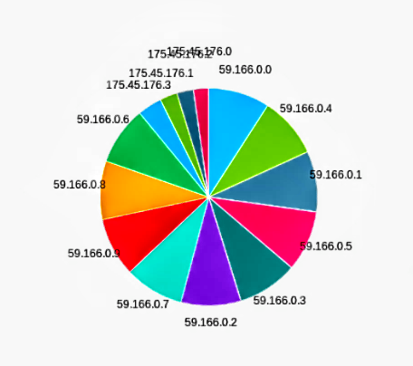
Hive Queries
Hive Query 2: Visualization

Slide 14

Advanced Analytics using Apache PySpark
Apache PySpark was installed on Google Colab and the UNSW-NB15 dataset was fetched by mounting Google Drive to Google Colab to conduct advanced analytics on the big data (UNSW-NB15 dataset) to further understand the data through some analytical methods including descriptive statistics and correlation. Then a binary and multi-class classifier were built to classify the data.
What is PySpark?
“PySpark is an interface for Apache Spark in Python. It not only allows you to write Spark applications using Python APIs, but also provides the PySpark shell for interactively analyzing your data in a distributed environment.”
(PySpark Documentation).

Slide 15
Analyze and Interpret Big Data
The dataset was defined using the spark.read.csv() method while the PySpark describe() function is used to compute descriptive statistics or summary statistics of the UNSW-NB15 dataset in PySpark on Google Colab.
Take for instance: UNSWNB15.describe().show()
The above syntax returns general descriptive statistics of the UNSWNB15 in PySpark as listed below:
Count – Count/ total number of values of each column
Mean – Mean value of each column
Stddev – standard deviation of each column
Min – Minimum value of each column
Max – Maximum value of each column
Below is a screenshot of the input scripts and the results.
Define & Describe UNSW-NB15 Dataset
#Define the UNSW-NB15 Dataframe
UNSWNB15=spark.read.csv('/content/drive/MyDrive/UEL-UNICAF/Module 3: Big Data Analytics/Assessment/UNSW-NB15.csv', inferSchema=True )
#Describe/Summary Statistics of UNSWNB15 Dataframe
UNSWNB15.describe().show()

Slide 16
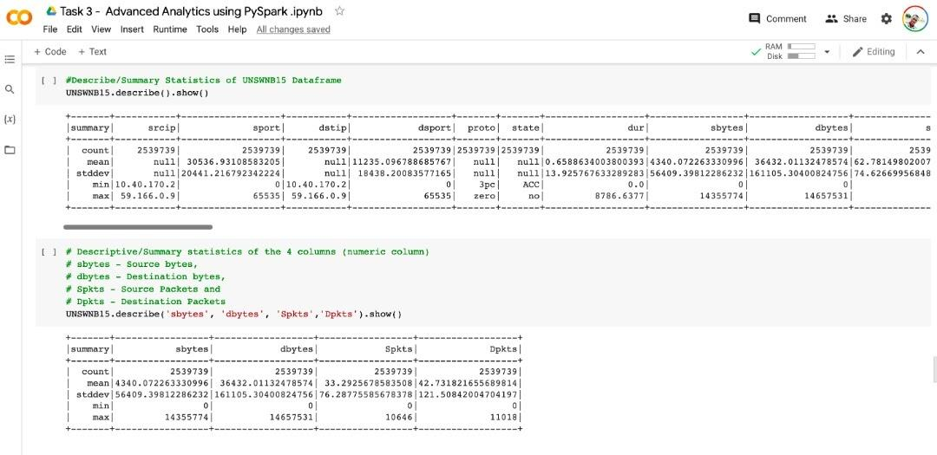

Advanced Analytics using Apache PySpark
Analyze and Interpret Big Data
See **Descriptive Statistics** in my Google Colab Notebook - https://colab.research.google.com/drive/19jb2Q7oSOC3zFSm0chXYs4C5LCNpGWT8#scrollTo=eyz13XfBBHbv&line=1&uniqifier=1

Slide 17
Analyze and Interpret Big Data
The correlation between sbytes and dbytes columns were analyzed using UNSWNB15.stat.corr('sbytes', 'dbytes'). Hence, the correlation of sbytes and dbytes columns is 0.04702553278490288 as demonstrated below.
The correlation between sbytes and dbytes as demonstrated below implies no relationship in the change of the variables (That is the bytes transmitted from the source to the destination are not relative to the bytes transmitted from the destination to the source).
Correlation between sbytes & dbytes
#Correlation of sbytes and dbytes column.
UNSWNB15.stat.corr('sbytes','dbytes')

Slide 18
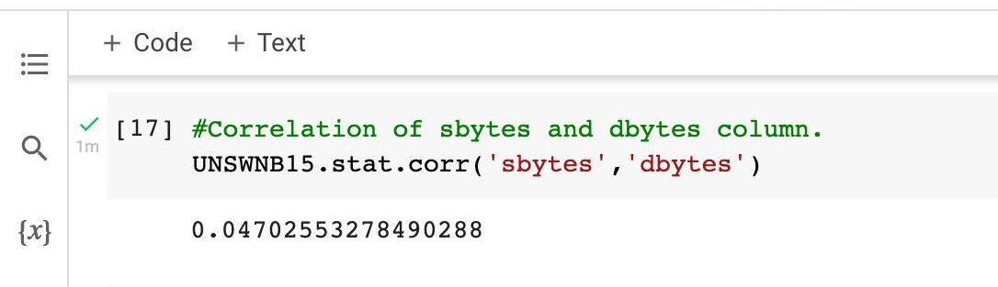
Advanced Analytics using Apache PySpark
Analyze and Interpret Big Data
See **Correlation** in my Google Colab Notebook - https://colab.research.google.com/drive/19jb2Q7oSOC3zFSm0chXYs4C5LCNpGWT8#scrollTo=2s4GgMNho_D9&line=1&uniqifier=1

Slide 19
Design and Build a Classifier
The dataset features were manipulated or preprocess so they are in the format MLlib requires. The algorithms (logistic regression) require numeric features, therefore the StringIndexer and OneHotEncoder were used to convert categorical variables into a set of numeric variables that only take on values 0 and 1. All the feature columns were then combined into a single feature vector using VectorAssembler provided by MLlib, then the model was defined using logistic regression in the code snippet on the left.
A pipeline was automated and ensure repeatability of the transformations to be applied to a dataset by defining the pipeline and then applying it to the test dataset. Similar to what was done with StringIndexer, Pipeline is an estimator which I called using the pipeline.fit() method to return a PipelineModel, which is a transformer.
To evaluate the model, the BinaryClassificationEvaluator was used to evaluate the area under the ROC curve and the MulticlassClassificationEvaluator to verify the accuracy. The Area under ROC curve is 0.9502324167040523 while the Accuracy is 0.8729554102762472 as shown below.
Model Definition
#Import LogisticRegression
from pyspark.ml.classification import LogisticRegression
#Model definition using LogisticRegression
lr=LogisticRegression(featuresCol="features", labelCol="label", regParam=1.0)

Slide 20
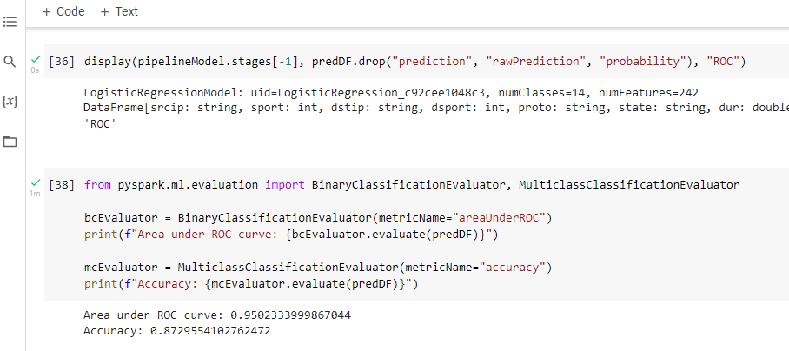
Advanced Analytics using Apache PySpark
Design and Build a Classifier
See code from my Google Colab Notebook - https://colab.research.google.com/drive/15p1SaFsPziyJGrqbH4D5EBbdwDCwQ_EP?usp=sharing

Slide 21
Alternative Technologies for Hive & PySpark
Presto
“Presto is an open-source distributed SQL query engine for running interactive analytic queries against data sources of all sizes ranging from gigabytes to petabytes.” - StackShare
Apache HBase
The Hadoop database is a big data store that is distributed and scalable. Apache HBase is an open-source, distributed, versioned, column-oriented database similar to Google's Bigtable (StackShare).
Apache Impala
Impala is an MPP SQL query engine for Apache Hadoop which is modern and open source. It allows you to query data stored in HDFS or Apache HBase in real-time, including SELECT, JOIN, and aggregate functions (StackShare).
How they Differs
Presto is optimized for low latency, whereas Hive is intended for high query throughput and queries requiring large memory. Furthermore, Spark is more general in its applications and is frequently used for data transformation and Machine Learning workloads (Alla, 2018) while Presto supports querying data in object stores like S3 by default and has numerous connectors available. | Hive performs batch processing operations that take a long time to complete and return a result. Whereas, HBase is used mostly for fetching or writing data and is faster than Hive. Additionally, Hive is a SQL-like query engine that runs MapReduce jobs on Hadoop, whereas HBase is a Hadoop NoSQL key/value database (Meher, 2021). | Impala does not support complex types, whereas Hive does. Also, Spark can run both short and long-running queries and recover from mid-query faults, while Impala is more focused on the short queries and is not fault-tolerant (Ahmed, 2020).

Slide 22
References
Ahmed, H. (2020, November 26). The Big Data Showdown: Apache Spark vs Impala. Naukri.com. https://www.naukri.com/learning/articles/spark-vs-impala
Alla, S. (2018). Real-Time Analytics with Apache Spark. In Big Data Analytics with Hadoop 3: Build Highly Effective Analytics Solutions to Gain Valuable Insight into Your Big Data.
Apache Hive vs HBase | What are the differences? StackShare. https://stackshare.io/stackups/apache-hive-vs-hbase
Axelsson, S. (2000). Intrusion detection systems: A survey and taxonomy (Vol. 99). Technical report.
Aydın, M. A., Zaim, A. H., & Ceylan, K. G. (2009). A hybrid intrusion detection system design for computer network security. Computers & Electrical Engineering, 35(3), 517–526. https://doi.org/10.1016/j.compeleceng.2008.12.005
Heady, R., Luger, G. F., Maccabe, A., & Al, E. (1990). The architecture of a network level intrusion detection system. University Of New Mexico. Department Of Computer Science. College Of Engineering.
IBM. (2020). What is Apache Hive? Www.ibm.com. https://www.ibm.com/analytics/hadoop/hive
MIT Lincoln Laboratory. (2000). 1998 DARPA Intrusion Detection Evaluation Dataset | MIT Lincoln Laboratory.

Slide 23
References
Moustafa, N., & Slay, J. (2015). UNSW-NB15: a comprehensive data set for network intrusion detection systems (UNSW-NB15 network data set).
PySpark Documentation — PySpark 3.2.1 documentation. Spark.apache.org. https://spark.apache.org/docs/latest/api/python
Section.io. (2021, September 12). Multi-Class Text Classification with PySpark. Engineering Education (EngEd) Program | Section. https://www.section.io/engineering-education/multiclass-text-classification-with-pyspark/#building-model
Zoghi, Z., & Serpen, G. (2020). UNSW-NB15 Computer Security Dataset: Analysis through Visualization. https://arxiv.org/pdf/2101.05067.pdf

